Slide 1
Royalty / Rental Income
Pub 4012 Tab D
(Federal 1040-Line 17)
(NJ 1040-Line 22)
Notes:
1

Slide 2
Royalty/Rental Income Schedule E
Royalties can be reported on client’s K-1 or 1099-MISC – IN SCOPE
Rental income for oil leases with no expenses –
IN SCOPE
Rent can be reported on 1099-MISC
Rent reported on K-1 is OUT OF SCOPE
Rental income on residential property – OUT OF SCOPE
Enter rents or royalties as income on Sch E Lines 3 & 4. TW transfers to 1040 Line 17
Notes:
Counselors who do a return with rental income on residential property that is Out of Scope can be held liable for any mistakes
2

Slide 3
Special Topics on TaxPrep4Free.org
See TaxPrep4Free.org Preparer page Special Topics documents
“Rent or Royalties on 1099-MISC”
“K-1 Income Entry”

Slide 4
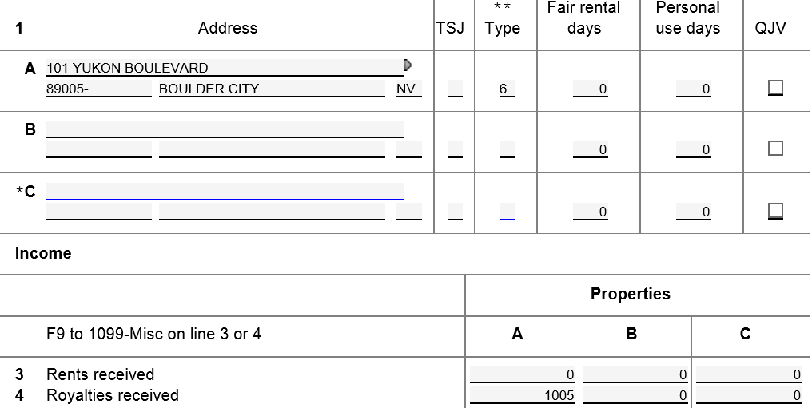
TW Schedule E Rents/Royalties
Code for Royalties
Enter from K-1 or link to 1099-MISC

Slide 5
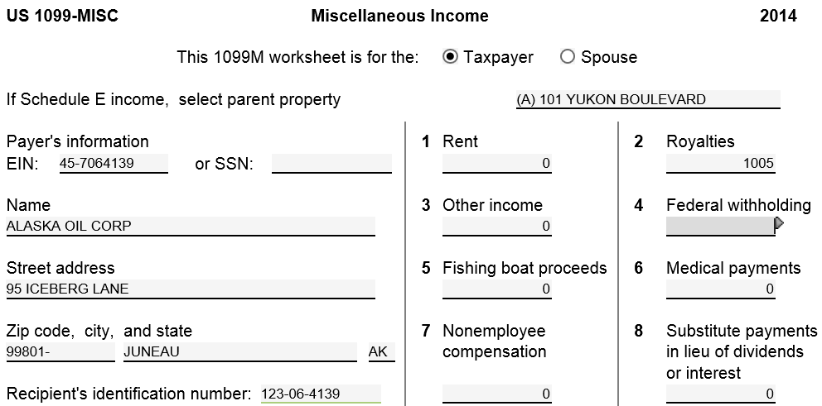
TW 1099-MISC Royalties
Use drop down menu to
choose property to link to
Notes:
Since taxpayer may have rents or royalties on several properties on Sch E, link each 1099-MISC to a specific property by using drop down menu at top of screen

Slide 6
TW Rent/Royalties on 1040
TW transfers from Schedule E
Notes:
TW transfers total from Schedule E to 1040 Line 17
6

